Slide 1
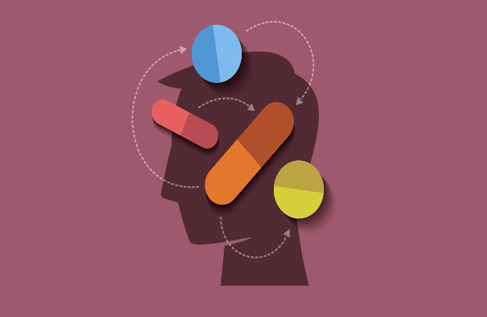
MENTAL HEALTH AND EMOTIONAL QUOTIENT ANALYSIS AND IMPROVEMENT USING ARTIFICIAL INTELLIGENCE.
Mayank Lodha
Srushti Patil
Pragya Gera
Neha Runwal
Atharva Dharane

Slide 2
Project Elements
Problem Statement
Introduction
Technology Overview
Application Flow
Innovation Criteria
Dimensions
Potential Clients and Collaborators
Audience Responses
Twitter Analysis

Slide 3
Problem Statement
To identify and analyse one of the major human problems which is Mental Health and Emotional Quotient.

Slide 4
Introduction
Drastic Increase in mental health issues.
Fact: 16.2 million adults in the USA, or 6.7 percent of American adults face depression every year.
Focus on Mental Health
Increase awareness about mental state
Measures to be taken and improvements to be suggested.
Early detection and prediction of common psychological disorders.

Slide 5
Technology Overview
Data Generation
IoT Devices- Apple watch, Fit-bit, web-cam
Social Media - Tweets , Facebook posts
Personal Response- Surveys
Algorithmic Approach
Association analysis,
Mood prediction,
Extrapolation and data analysis
Data Visualization
Artificial Neural Network
Data Storage
Cloud- Encrypted data

Slide 6
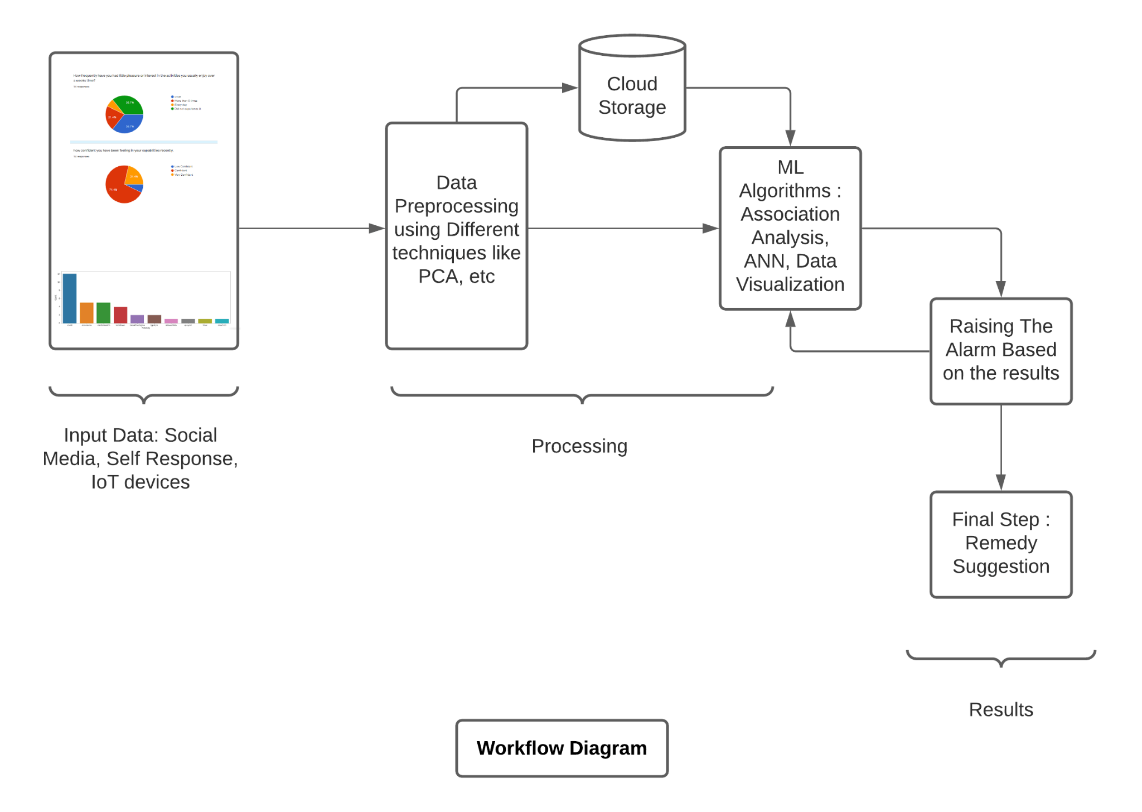

Slide 7
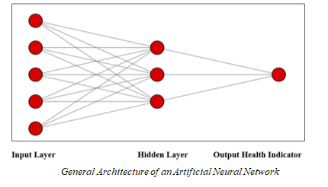
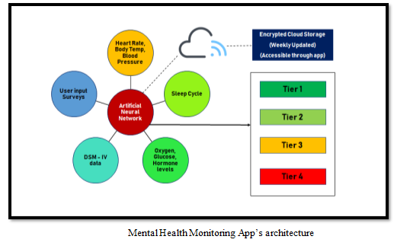

Slide 8
Tier 1: Minor (0.0)
· Suggesting time off work or time away from a screen.
Tier 2: Minor (1.0)
· Suggesting public meetups and events to relieve stress.
Tier 3: Major (2.0)
· Suggesting exercise routines, meditation tutorials, yoga classes etc.
Tier 4: Critical (3.0)
· Suggesting seeking professional help from mental health experts, providing their contact information and opening an interface to book appointments.

Slide 9
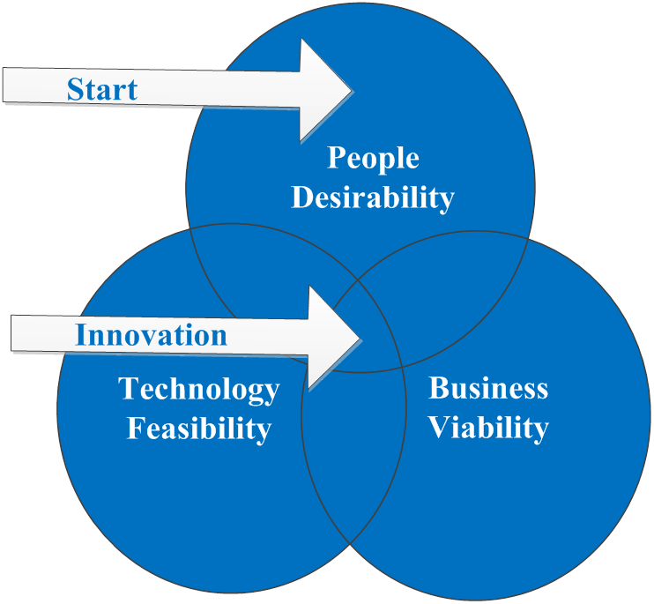
Innovation Criteria
High consumer desirability. Monitoring based on real time data.
Mental Health Quotient
Risk Factor & Cause Analysis.
Precursor Recognition.

Slide 10
Dimensions
Functional : Improved tools for mental health analysis and visualization. Better prediction and detection of mental health conditions.
Social : Improved social relations of an individual which is highly affected by the individual’s mental state.
Emotional: Improved overall mental well-being.

Slide 11
Potential Clients and Collaborators
Primary Clients : working class, people suffering PTSD, common people.
Secondary Clients : Psychologists and other healthcare practitioners
Potential Collaborators : IBM Watson Health, Google Health, Apple, Noise, Fitbit

Slide 12
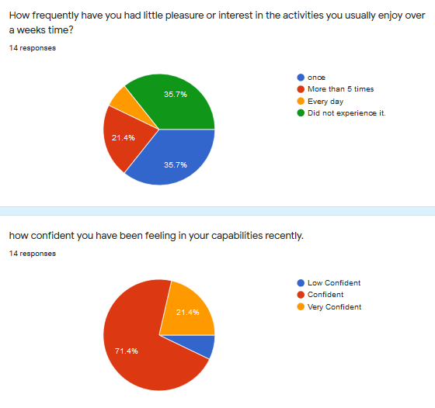
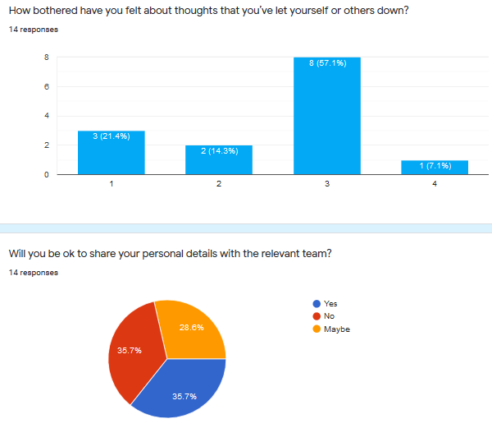
Audience Responses

Slide 13
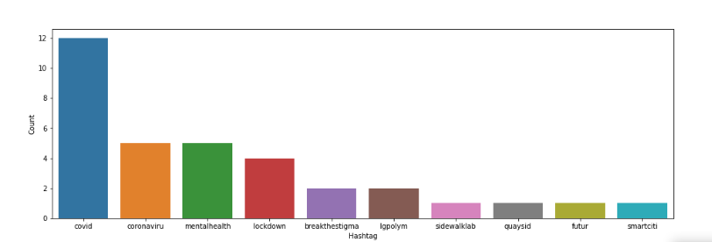
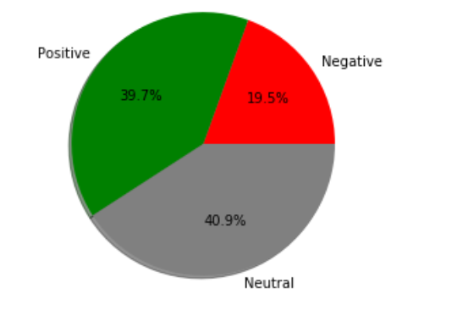
Twitter Analysis

Slide 14
References
[1] Innovation and Entrepreneurship: A competency Framework. By - Charles H. Matthews and Ralph Brueggemann
[2]http://www.ijcea.com/jasper-speech-tool-based-intelligent-console/
[3]https://www.mckinsey.com/industries/healthcare-systems-and-services/our-insights/rebuilding-clinician-mental-health-and-well-being-after-covid-19
[4] https://www.mckinsey.com/featured-insights/artificial-intelligence/tackling-bias-in-artificial-intelligence-and-in-humans

Slide 15
THANK YOU!

